Slide 1
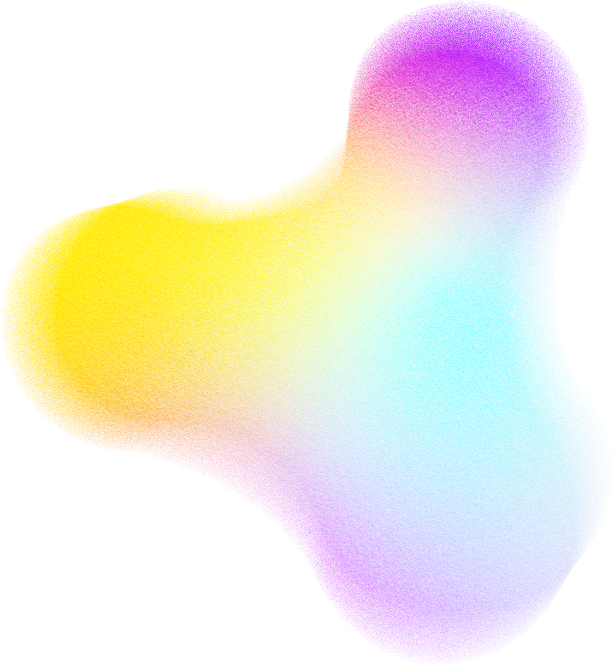
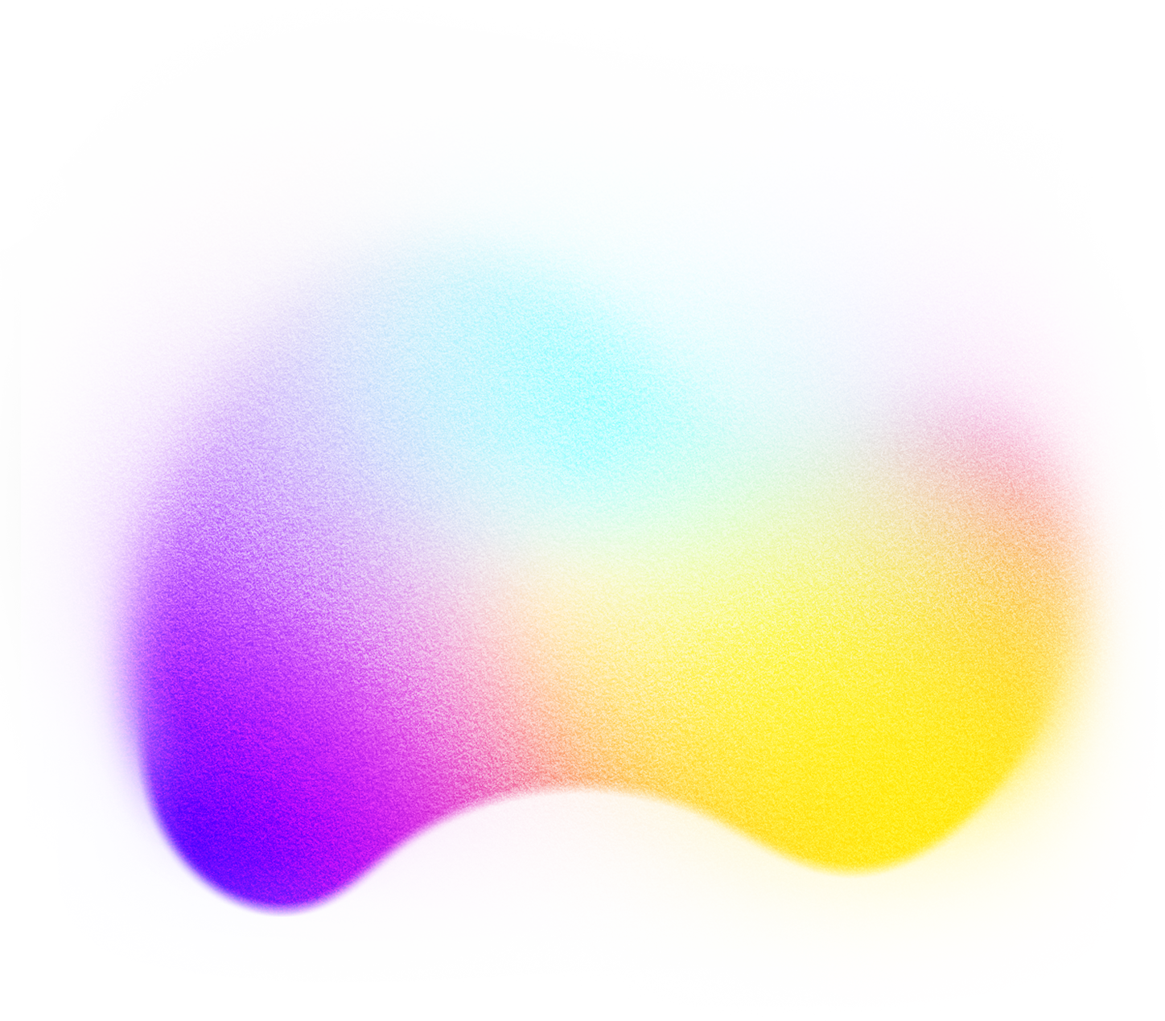
AI-POWERED PERSONAL COLOR ANALYSIS
PERSONALIZED FASHION RECOMMENDATION
Raviteja Gundu, Aaris Khan, Divya Avuti, Divya Navale

Slide 2
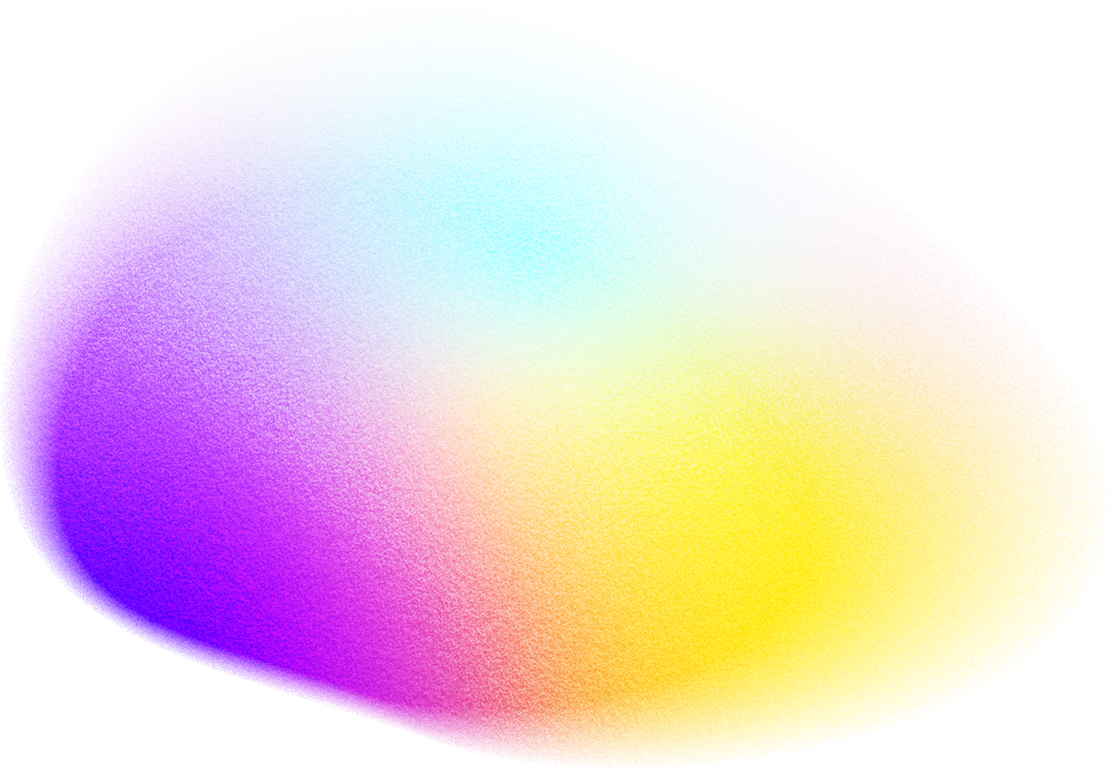
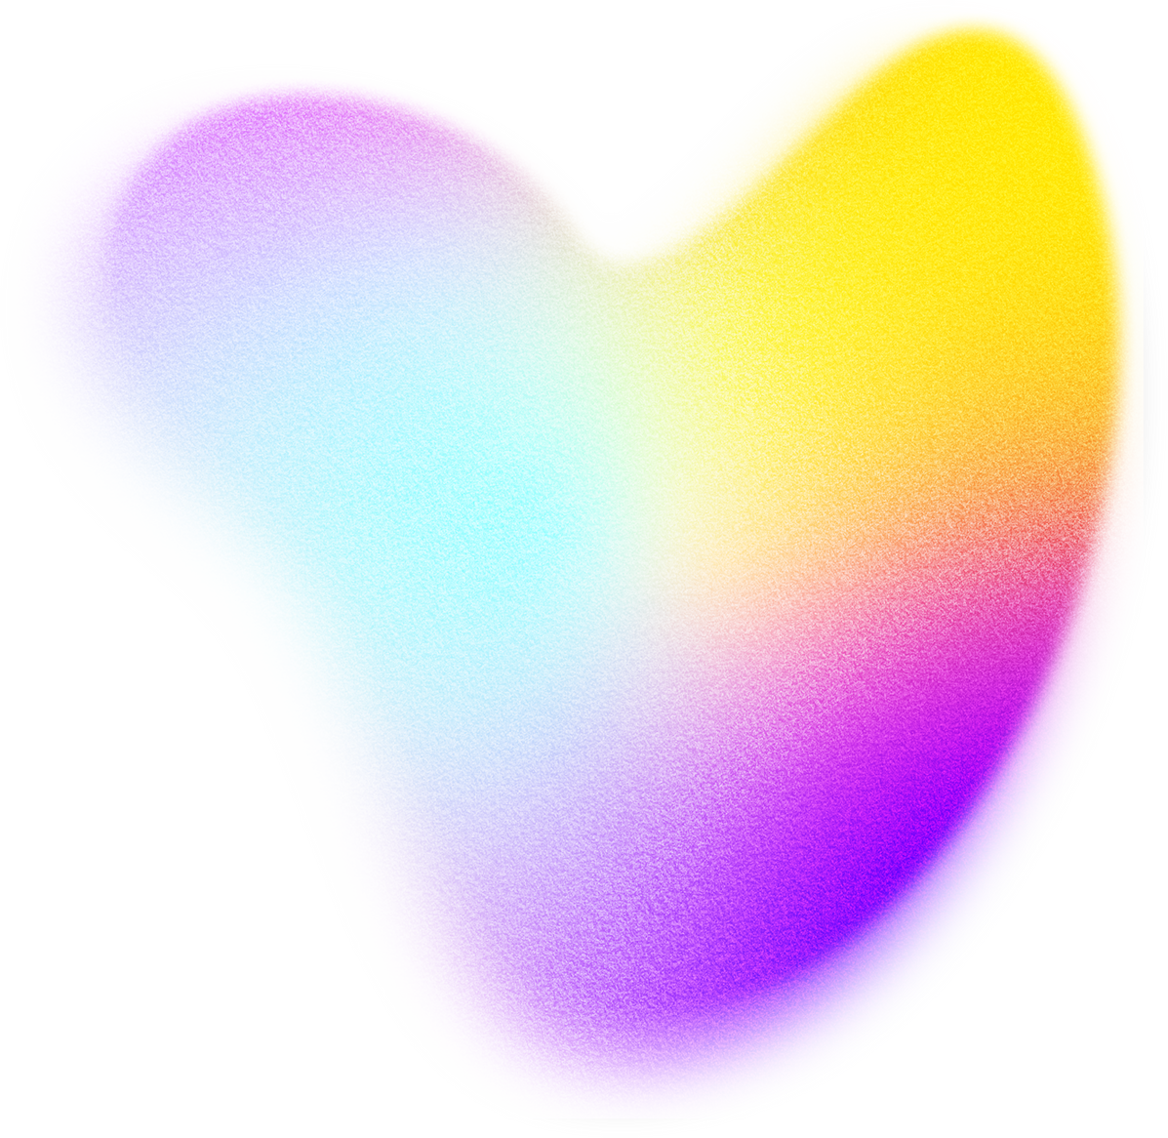

Citations
Deep Armocromia Dataset:
Stacchio, L., Paolanti, M., Spigarelli, F., & Frontoni, E. (2025).
Deep Armocromia: A novel dataset for face seasonal color analysis and classification.
In A. Del Bue, C. Canton, J. Pont-Tuset, & T. Tommasi (Eds.),
Computer Vision – ECCV 2024 Workshops (pp. 352–367).
Springer Nature Switzerland.
Link: https://doi.org/10.1007/978-3-031-91569-7_22
Seasonal Color Analysis (To understand color palette recommendation)
Link: https://theconceptwardrobe.com/colour-analysis-comprehensive-guides/seasonal-color-analysis-which-color-season-are-you
Deep Armocromia Research Paper:
Link:https://www.researchgate.net/publication/383463705_Deep_Armocromia_A_Novel_Dataset_for_Face_Seasonal_Color_Analysis_and_Classification
Facer for masking:
Link: https://github.com/FacePerceiver/facer

Slide 3

Tech Stack
FRONTEND
BACKEND
React 19.1.1 + TypeScript 5.8.3 + Vite 7.1.7
Tailwind CSS for styling
Lucide React for icons
FastAPI 0.104.1 (Python web framework)
Uvicorn 0.24.0 (ASGI server)
PyTorch 2.0.1 + TorchVision 0.15.2 (ML framework)
MongoDB (via PyMongo 4.10.1)
MACHINE LEARNING AND IMAGE PROCESSING
DEVELOPMENT AND DEPLOYMENT
ResNeXt50_32x4d (pre-trained, fine-tuned for color classification)
Facer (face detection)
Rembg (background removal)
ColorThief (color extraction)
Pillow 10.1.0
NumPy 1.24.3
ONNX Runtime 1.16.3
Git + GitHub
ESLint + TypeScript ESLint
Python venv + npm
Google Cloud
NGNIX
Docker

Slide 4
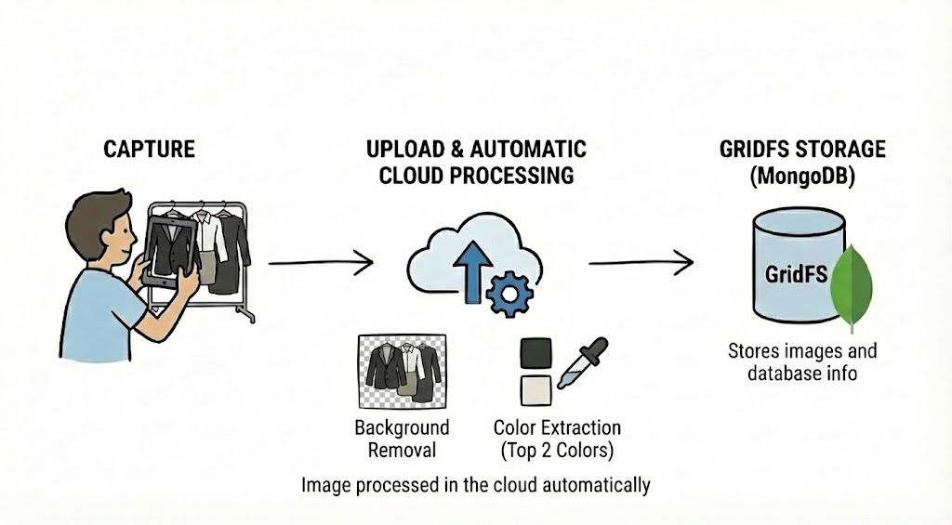
Career closet processing

Slide 5
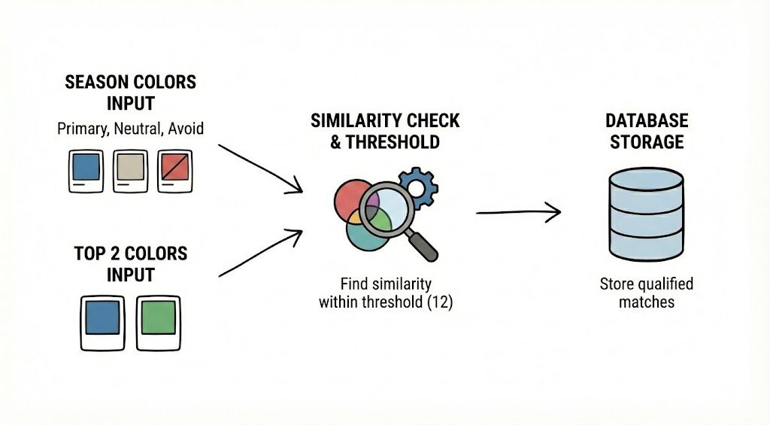
Season color vs Top 2 color match

Slide 6
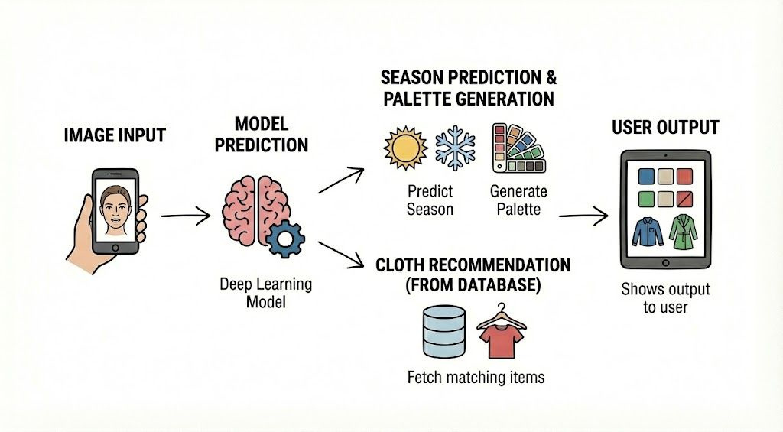
Application Workflow

Slide 7
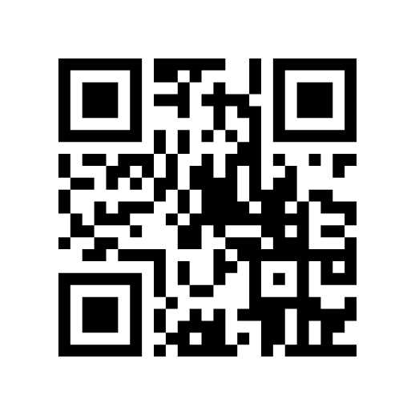
Demo Time!
https://color-analysis.me

Slide 8
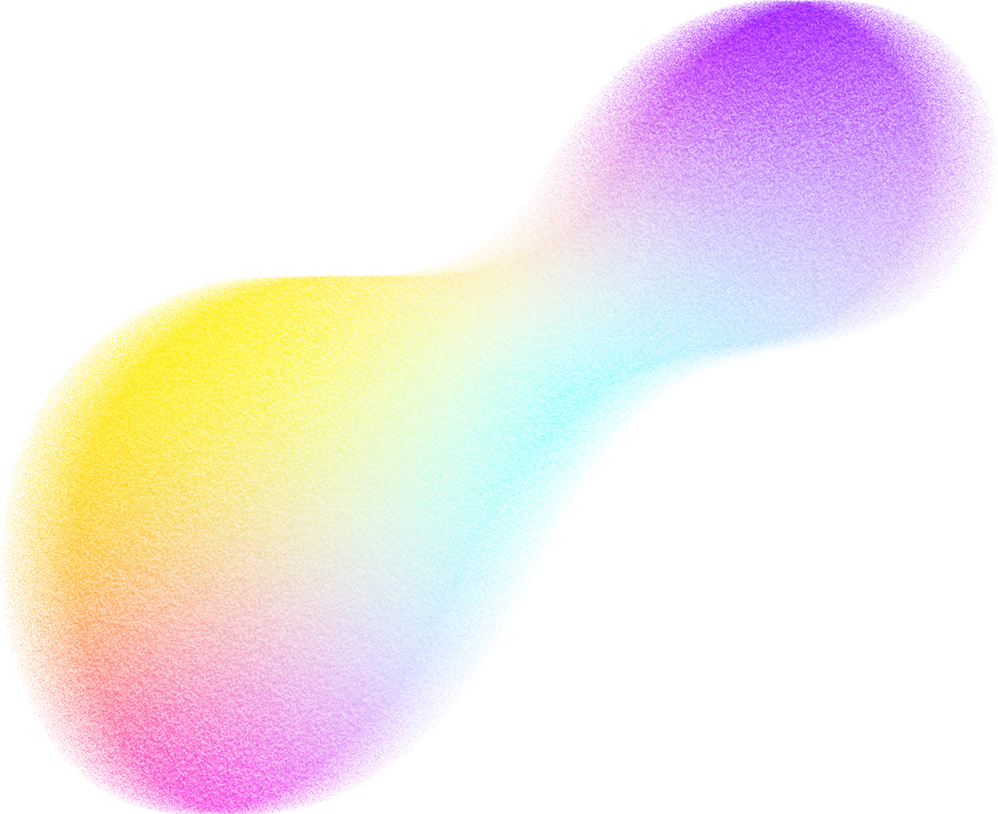
Group Project Experience

Slide 9
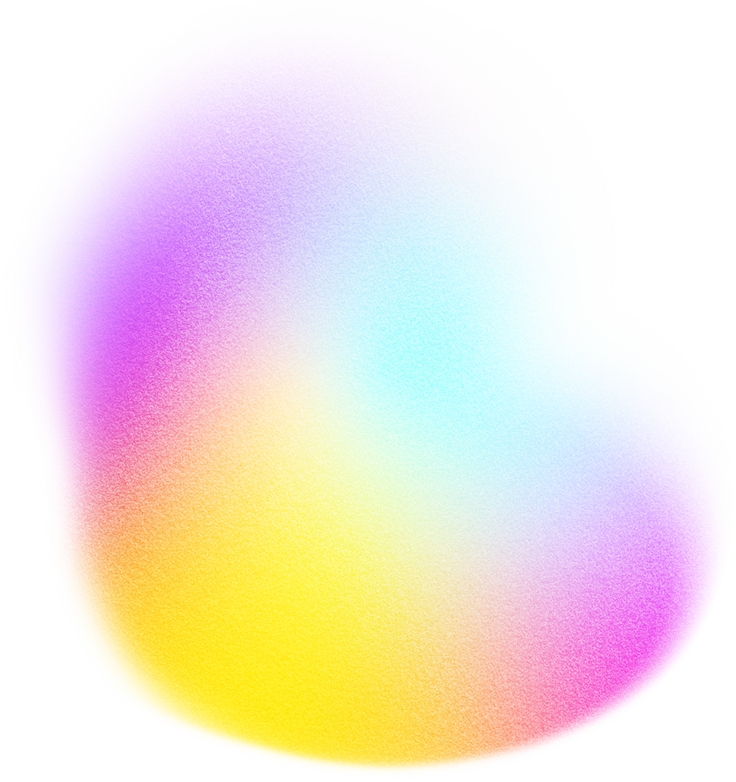
GOOD EXPERIENCE
BAD EXPERIENCE
Strong team communication.
Equal contribution from all members.
Everyone stayed in sync throughout the project.
Faced timing conflicts while coordinating work.
GPU limitations slowed down model training.
WHAT WE SHOULD KEEP DOING
WHAT SHOULD BE IMPROVED
Short feedback loops
Frequent real user testing
Structured GitHub workflow
Performance Optimization Before Deployment

Slide 10
CURRENT LIMITATIONS
Lighting: Still affects prediction accuracy without a color-calibrated environment
Dataset: Imbalance reduces accuracy for certain skin tones and warm seasons
Subjectivity: Seasonal color theory itself can be subjective and interpretive

Slide 11
FUTURE WORK & IMPROVEMENTS
Event-based Recommendations: Suggest items tailored to your formal, party, or everyday occasions.
Virtual Try On: Lets you preview products with realistic digital overlays on yourself.
Improve Model Accuracy: Boost model’s performance by expanding data and refining training methodologies.
Admin Panel: To handle inventory.

Slide 12
RESULT
Completed full end-to-end AI-powered color analysis system
Added personalization using confidence-weighted logic
Improved usability through better preprocessing and UI
Built a scalable foundation for wardrobe and outfit recommendations

Slide 13
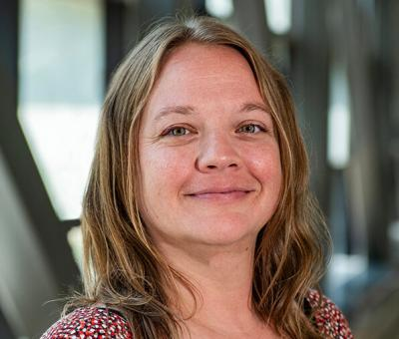
LISTEN FROM OUR CLIENT
Melody Monday
Senior Career Counselor

Slide 14
Q
uestions?

Slide 15
T
hank You

